Slide 1
DATA SCIENCE LAB.3 FINAL PROJECT
Aggelos Tako, Anastasia Zafeiriou, Anna Dosiou, Konstantinos Christou

Slide 2
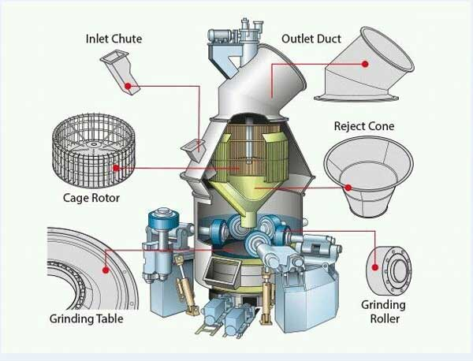
CEMENT MILL PROCESS
The Cement Mill grinds the hard, nodular clinker from the cement kiln into the fine grey powder that is cement. This cement mill produces two types of cement.
The production process is separated into two blocks. Those are the Separator Motor Block and the Mill Differential Pressure Block. There are given data for 6 months, from May to October.

Slide 3
TYPES OF PORTLAND CEMENT
CPII
CPIV
Composition: clinker, gypsum, pozzolanic materials
Durability: pozzolanic → chemical attacksꜜ, heat of hydrationꜜ, workabilityꜛ
Environmental Impact: carbon footprintꜜ, greenhouse gas emissionsꜜ, conserving natural resourcesꜛ
Composition: clinker, gypsum, supplementary cementitious materials (SCMs)
Durability: SCMs → risk of crackingꜜ, strengthꜛ, chemical, sulfate attacksꜜ, alkali-silica reactionsꜜ
Environmental Impact: CO2ꜜ, reliance on virgin raw materialsꜜ
Pro
Premium

Slide 4
CEMENT MILL BLOCKS
Separator Motor
Separator Speed
Mill Differential Pressure
Mill Differential Pressure
Total Feed
Bucket Elevator
Fly Ash 1,2
Fan Speed
Separator Speed
Grinding Pressure
Mill Water Injection

Slide 5
Challenges of the datasets
Errors, NaN Values, Time Gaps
Duplicate Columns
Time Delay between Timeseries
Separation of Smooth Motor Operation
Data Type (e.g. Date/Time, Integer/Float)

Slide 6
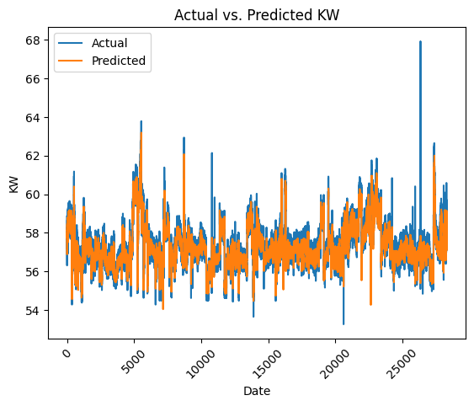
Block 1: Separator Motor Block
Predicted with LSTM
Train / Test Set: 80 / 20 %
Performance
RMSE: 0.459 MAPE: 0.006 R^2: 0.832 MAE: 0.357

Slide 7
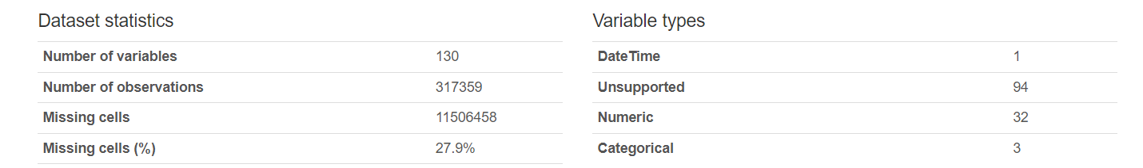
Cleaning and Preprocessing
Handling Missing Data and Errors
Merging Duplicate Columns (e.g. gypsum, total feed)
Defining proper date / time format
Converting Data Types

Slide 8
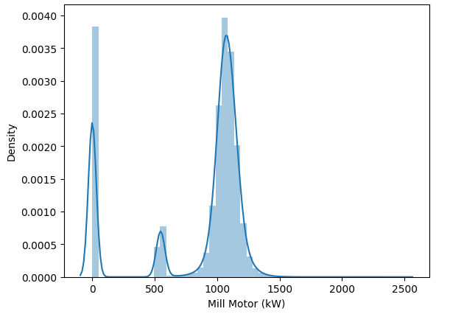
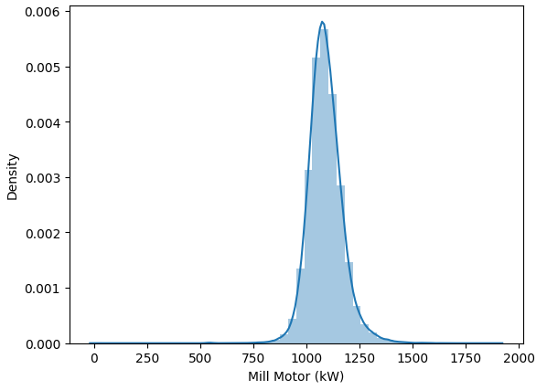
Exploratory Data Analysis (EDA)
Distribution of Mill Motor Operation (KW) – Normal Operation

Slide 9
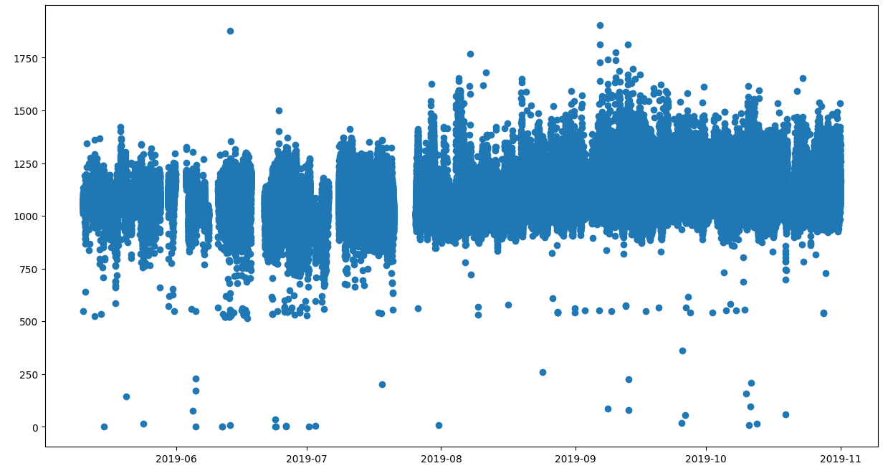
Exploratory Data Analysis (EDA)
Mill Motor Timeseries
Separator Motor (KW)
Interrupted operation in the first months
After possible maintaining process the mill is operating in a higher power level

Slide 10
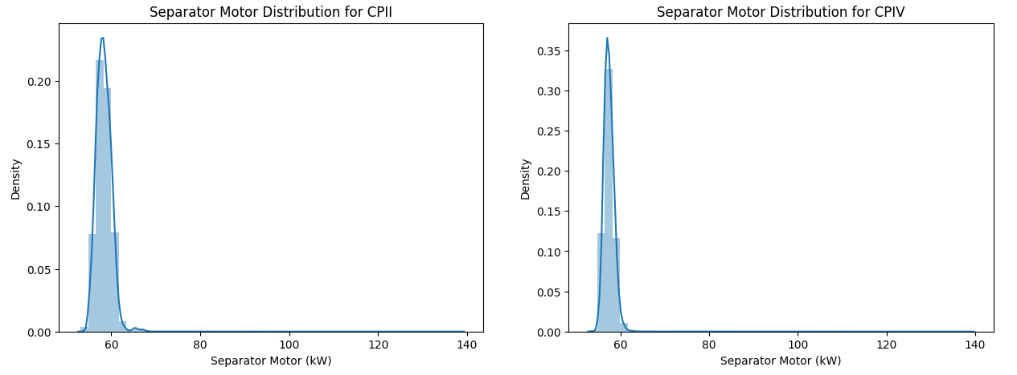
Exploratory Data Analysis (EDA)
Distribution of Separator Motor (KW) per Cement Type

Slide 11
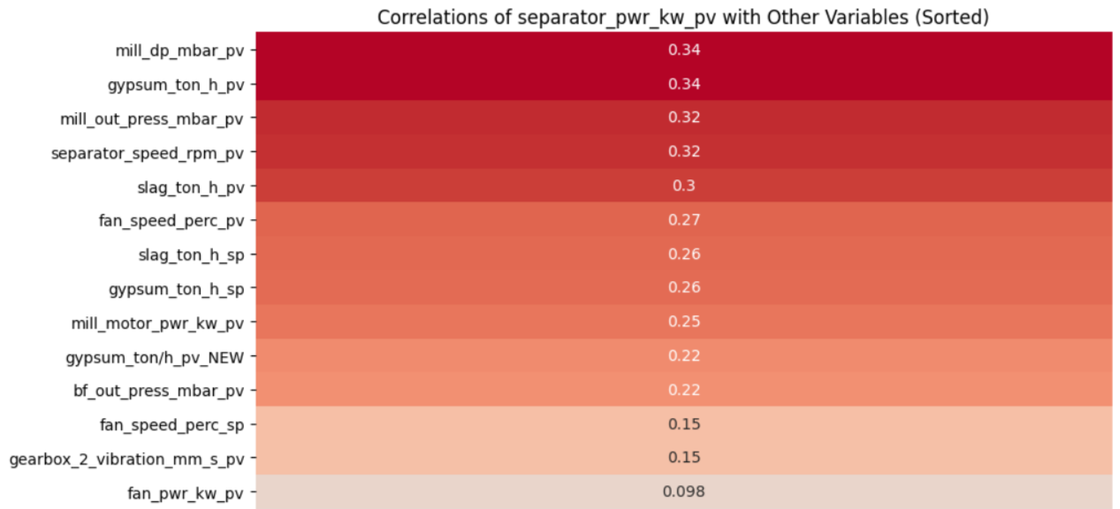
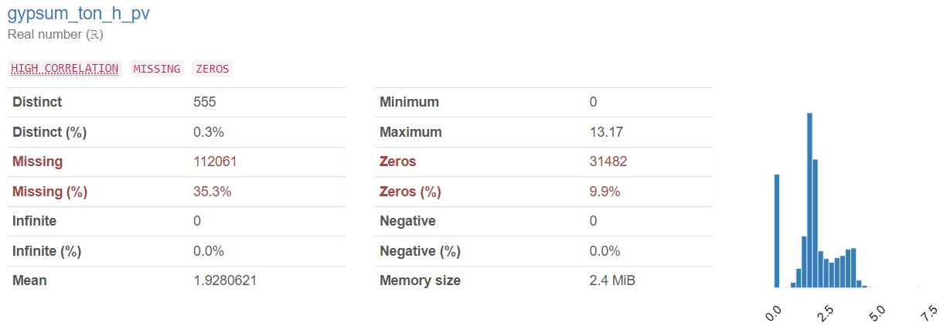
Exploratory Data Analysis (EDA)
Correlations

Slide 12
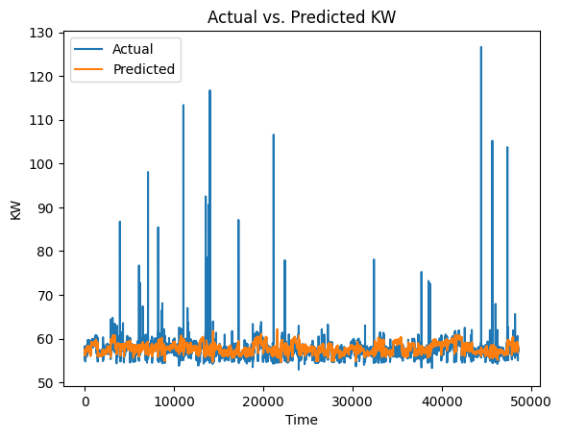
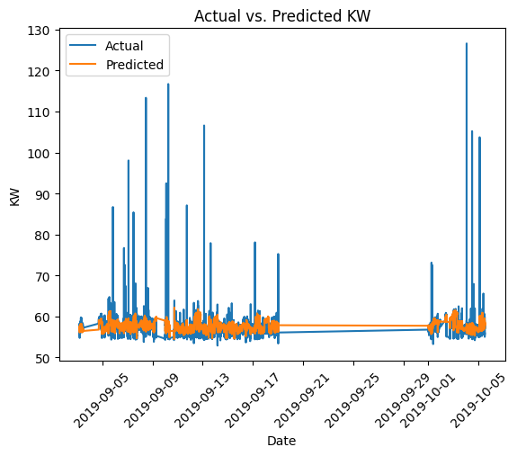
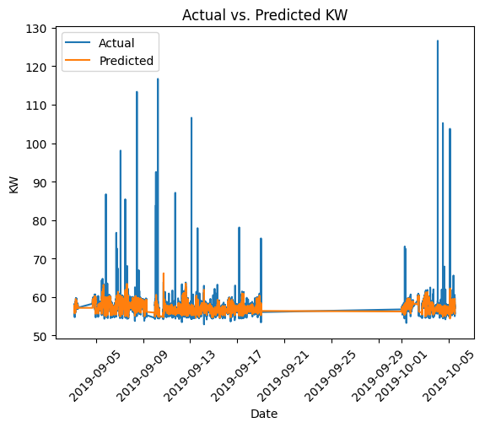
Block 1: Separator Motor Block
Predicted with LSTM
Inputs: Separator Speed, Mill DP, Cement Type, Gypsum
Performance
RMSE: 0.949 MAPE: 0.006 R^2: 0.585 MAE: 0.385
Predicted with LSTM
Inputs: Separator Speed, Mill DP
Performance
RMSE: 1.293 MAPE: 0.0138 R^2: 0.230
Predicted with LSTM
Inputs: Separator Speed, Mill DP, Cement Type
Performance
RMSE: 1.283 MAPE: 0.013 R^2: 0.242 MAE: 0.785

Slide 13
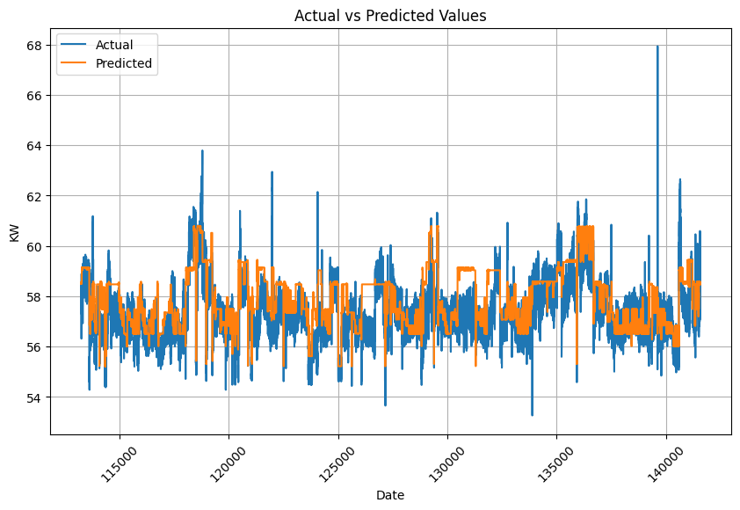
Block 1: Separator Motor Block
Machine Learning
Deep Learning
Predicted with Random Forest
Performance
RMSE: 1.025 MAPE: 0.013 R^2: 0.162 MAE: 0.793
Predicted with LSTM
Performance
RMSE: 0.459 MAPE: 0.006 R^2: 0.832 MAE: 0.357

Slide 14
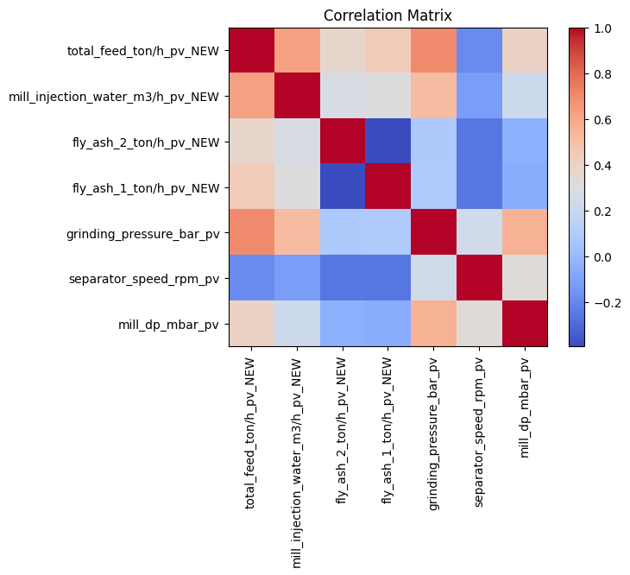

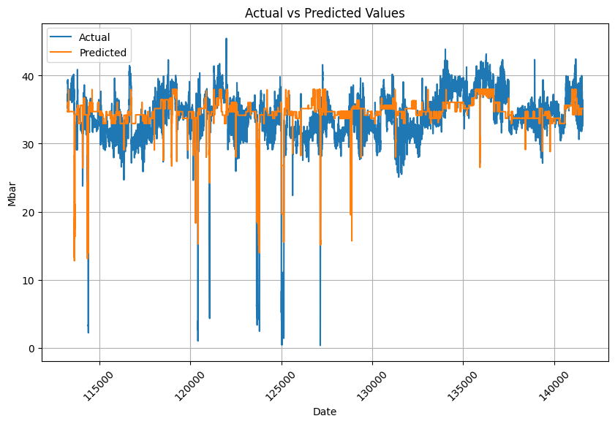
Block 2: Mill Differential Pressure Block
Random Forest
Inputs variables:
'total_feed_ton/h_pv_NEW',’
grinding_pressure_bar_pv’,
'separator_speed_rpm_pv’

Slide 15
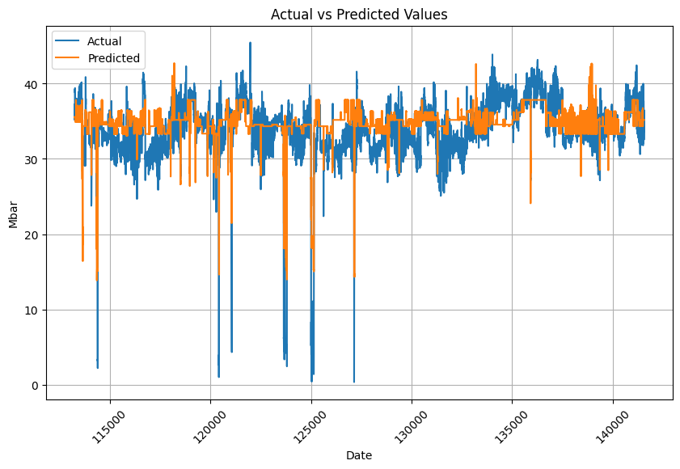
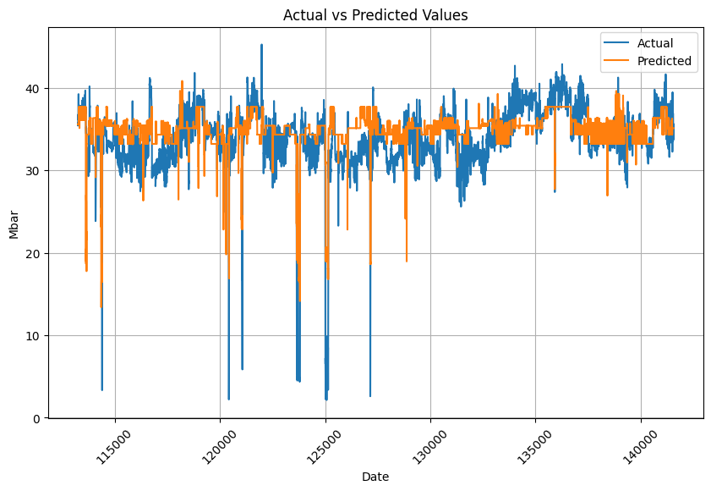
Block 2: Mill Differential Pressure Block
Machine Learning
Input variables: total_feed, fly_ash_2, fly_ash_1, grinding_pressure, mill_injection_water, bucket_elv_mtr, separator_speed
Predicted with Random Forest
Performance
Mean Squared Error: 10.5455
Mean Absolute Error: 2.390
R-squared Score: 0.393
Predicted with Random Forest
Performance
Mean Squared Error: 10.251
Mean Absolute Error: 2.344
R-squared Score: 0.390

Slide 16
Suggestions for model improvement
01
02
Time Delay – DTW, Correlation Matrix
Model Training with Time breaks
03
04
Timeseries Smoothing - Reduce Noise
NN Model in Block 2

Slide 17
Thank you!

